Slide 1
AUDIO CLASSIFICATION
DEEP LEARNING SPRING 2024

Slide 2
Motivation

Slide 3
Dataset
Gtzan : 10000 training, 2000 validation
Free music Archive: 2000 testing

Slide 4
Proposed Solutions

Slide 5
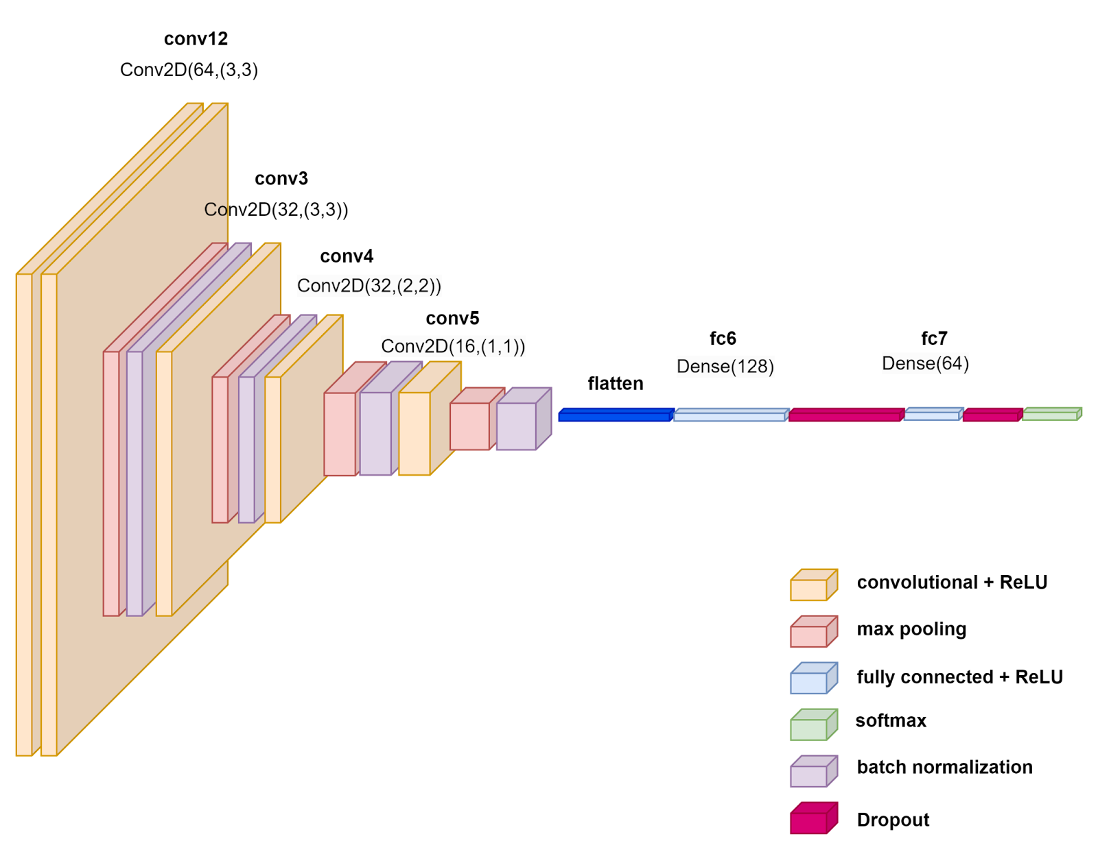
2D CNN

Slide 6
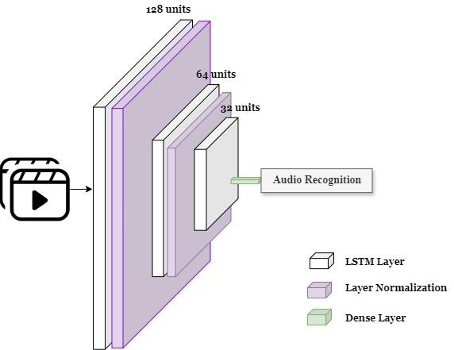
LSTM

Slide 7
Results
Accuracy score | n_mfcc = 13 (default) | n_mfcc = 40
seq_len = 15 | 0.289 | 0.34
seq_len = 20 | 0.273 | 0.314
LSTM accuracy : 0.27

Slide 8
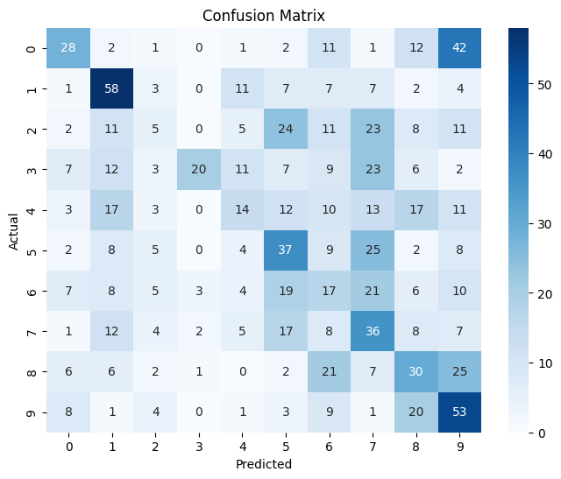


Slide 9
Demo time!

